Slide 1
Flex Charting:
Feature Spotlight for AlchemCharts
August 2017

Slide 2
Introduction
Flex Charting creates custom trading platforms for stock market seminars and educators
Expand Your Brand
Receive a custom charting platform designed to your trading specifications and branded to your liking
Increase Your Revenue
Use our expertise in developing and operating stock market charting platforms at no cost in exchange for you using your new custom made platform
Improve Your Trading
Removing distracting elements, incorporating external information, and pioneering new features makes finding and executing your strategy simpler
Flex Charting’s offerings can be demonstrated through a spotlight of its most popular platform, AlchemCharts

Slide 3
Survivor Series
AlchemCharts was created to support the Survivor Series seminars taught in North Carolina
Survivor Series is a 3 day, in-person seminar that focuses on stock and options trading using technical analysis executed around fundamental events.
The instructor stresses that trading requires a lot of practice along with The Millionaire Next Door mentality of anonymity
Survivor Series strategy uses a combination of half a dozen technical indicators coupled with several charting timeframes and a lot of after market calculations to find the perfect stocks
Students of Survivor Series are expected to do market study for 1-3 hours each night and historically had a 80% failure rate where only 20% of student’s made enough money to trade for a living

Slide 4
AlchemCharts
AlchemCharts’ main goal was to address the low success rate of Survivor Series students. Through its understanding of the Survivor Series, AlchemCharts aimed to:
Reduce the complexity of chart setup
Reduce the after market study by eliminating redundancies so that students only focused on study
Eliminate complex calculations
Maintain and enhance all features required to execute strategies
Simplify the platform by eliminating unnecessary features in traditional charting platforms
Flex Charting successfully met all requirements with AlchemCharts and saw:
An increase in success for Survivor Series students
90% of students who sign up for AlchemCharts stay on for at least 6 months

Slide 5
Key Features
Using AlchemCharts Examples

Slide 6
Custom Design
Survivor Series’ students originally used a platform called Qcharts for their daily charting needs
It was important to the instructor that the addition of AlchemCharts minimally disrupted the student body, so AlchemCharts was designed to look like QCharts.
Flex Charting can design the platform to your liking. If there is a platform you like the look of, we can design your platform accordingly. There is no limitation to the look of your platform.

Slide 7
Perfect Setup
Survivor Series’ students had trouble setting up their charts leading to unsuccessful trading
With the plethora of chart options and indicator parameters in traditional charting platforms, students were accidentally creating the wrong indicators
When setting up charts, AlchemCharts prohibits using any other indicators or parameters that are not used in Survivor Series instruction
Your platform will only be used for your strategy. Your students will never be sidetracked again by mistaken indicators or parameters.

Slide 8
Synced Scrolling
When studying the market, looking at historical charting intervals proved to be difficult in traditional charting platforms
Simultaneously viewing how a 55 min chart and a daily chart looked at 10:25 was not possible
AlchemCharts addresses this by creating the Synced Scrolling feature which will automatically show you what every chart looked like at the time of the focused chart
Features that let you see historical data can be implemented in your platform. We can break down historical data to the minute or smaller so that you can look back and see how things played out in real time.

Slide 9
Custom Calculations
Survivor Series’ students are tasked with performing various calculations in order to determine which stocks to trade the next day
Calculations can be mundane, take time, and are often performed incorrectly or skipped.
AlchemCharts performs these calculations for its users so students can spend more time on studying and ensure their calculations are done correctly
If you have custom calculations, stock selection criteria, or a stock screener, your platform can have the customizations built right into the platform.

Slide 10
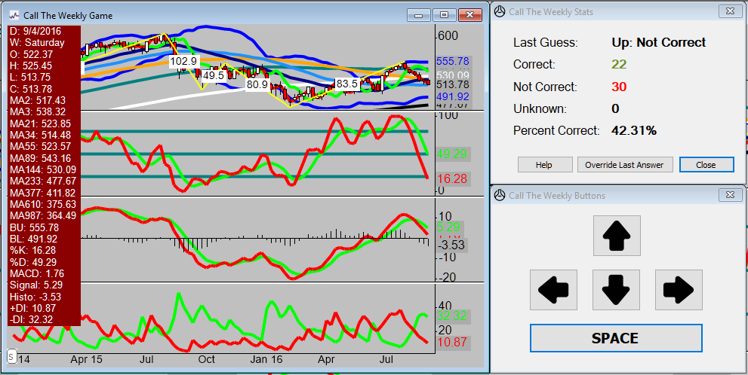
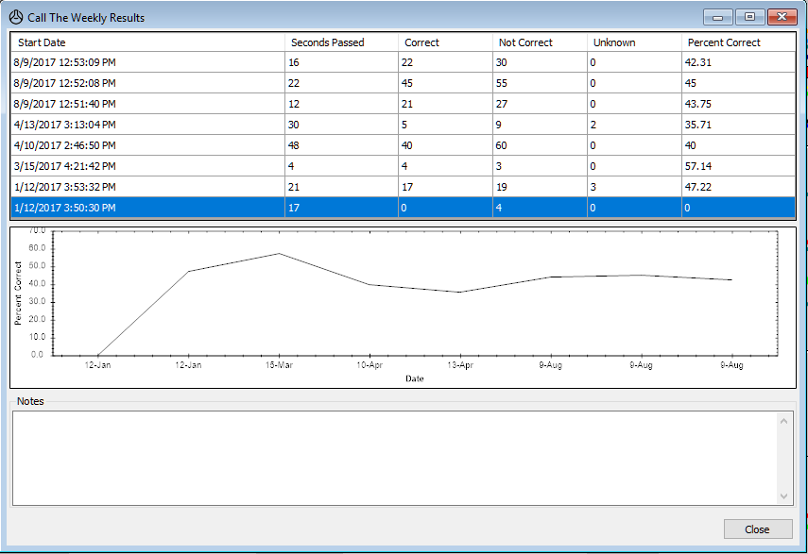
Custom Games/Tools
Because practice is very important for Survivor Series students, the instructor created a number of games to improve his students' abilities
AlchemCharts created custom features for the games to practice and track progress
For example, “Call the Weekly” game picks a random blind stock and asks the user to predict the color of the next candle
If you have ways to practice or improve your strategy, we can incorporate and streamline that practice tool in your platform.

Slide 11
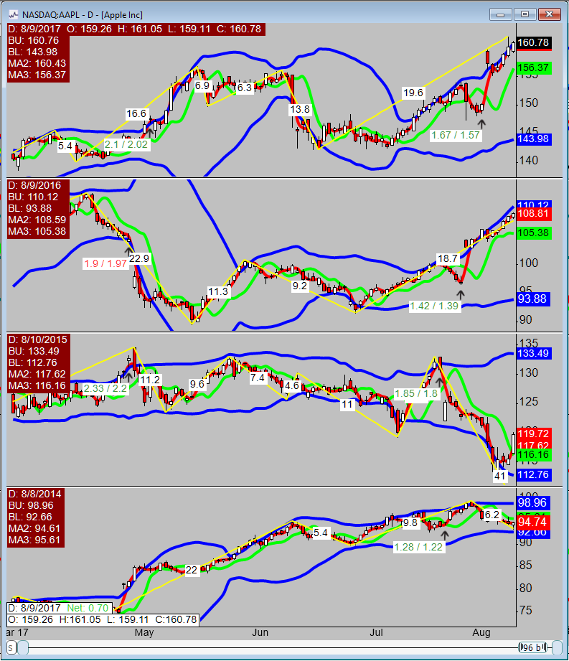
Research & Stock Analysis
With research being another important aspect to the Survivor Series, historical trends may indicate that you can trade with confidence
By stacking 4 years of stock movement on top of each other, AlchemCharts makes it easier for users to quickly identify patterns
If you would like your charts to look a specific way to perform historical stock analysis, this can be incorporated in your charting platform.

Slide 12
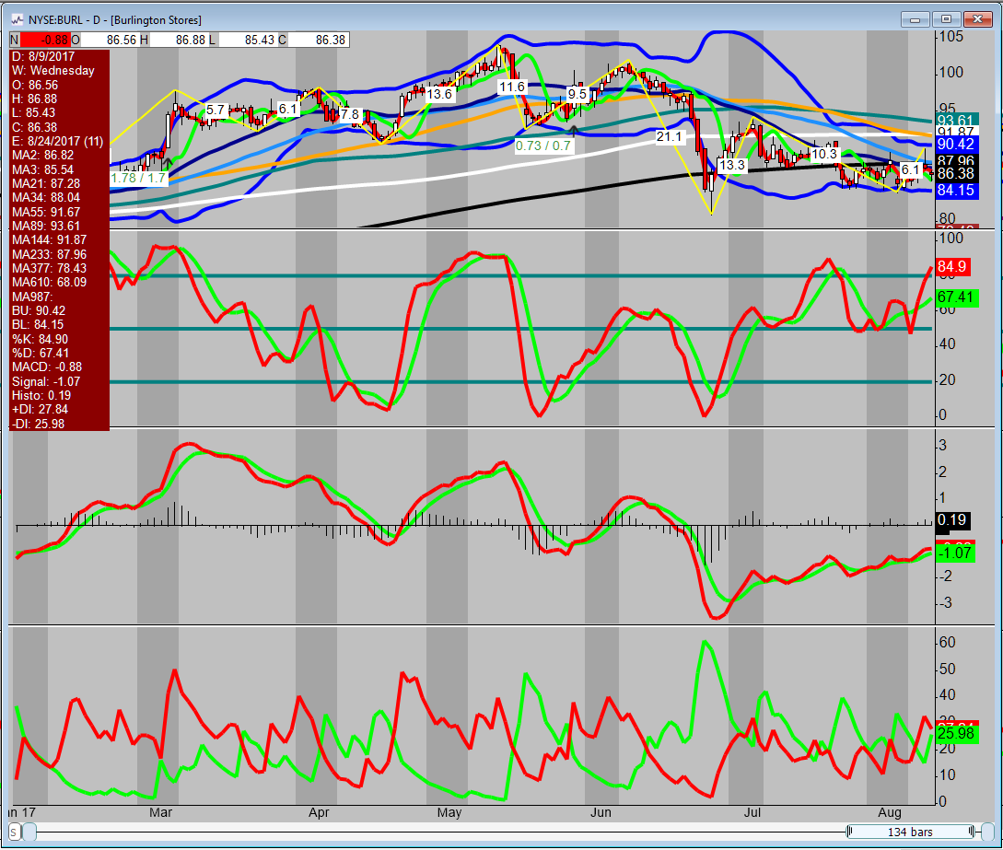
Fundamentals
Survivor Series teaches its students to trade around fundamental data like earnings and splits
Before AlchemCharts, students subscribed to certain newsletters and sites to get the information they needed and were required to toggle back and forth between the source and chart
AlchemCharts integrates this information by displaying earnings and splits dates and results on the charts
Indicators also let you know how far out the next event will occur
If there is anything that you use to make trading decisions outside of the charts, we can incorporate that into your platform so there is no need to tab between several applications.

Slide 13
Closing Remarks
TBD

Slide 14
Resources
Flex Charting
Michael Rutledge, michael@flexcharting.com
Grant Groves, grant@flexcharting.com
www.flexcharting.com
AlchemCharts
www.alchemcharts.com

